Slide 1
RibFrac challenge
Rib fracture detection
Martijn van Raaphorst
Diego Garcia Cerdas
Luka Wong Chung
Erencan Tatar
Egoitz Gonzalez

Slide 2
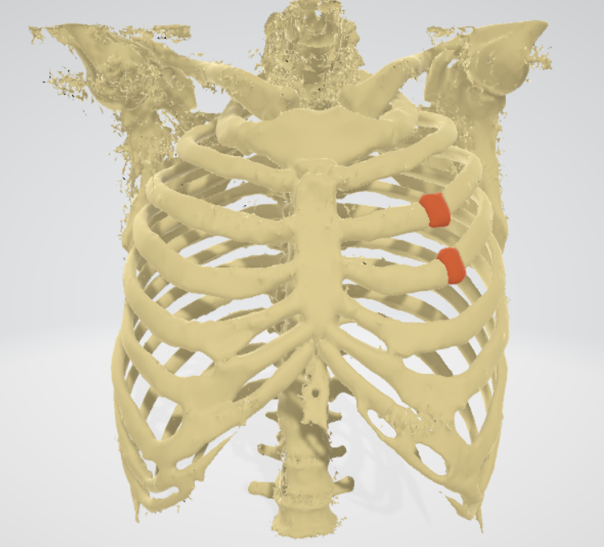
Problem
RibFrac 2020 challenge
Detection task
Prediction of a binary segmentation mask
3D CT scans

Slide 3
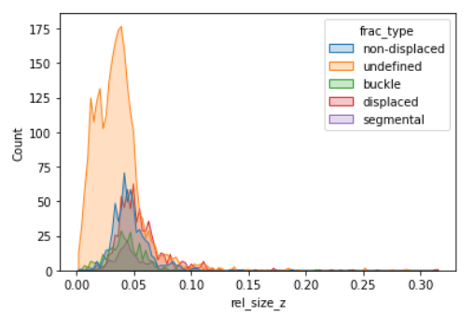
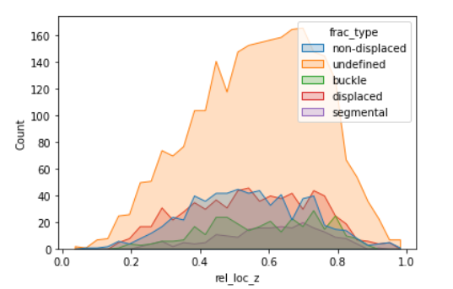
Data statistics

Slide 4
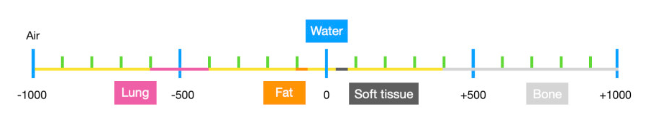
Approach
1. Fixed preprocessing for CT scan
Hounsfield (HU) scale → (get rid of soft tissue and lungs)
Notes:
It's like a number that tells us how much X-ray beams are blocked or absorbed as they pass through different parts of your body.

Slide 5
Approach
1. Fixed preprocessing for CT scan
Hounsfield (HU) scale → (get rid of soft tissue and lungs)
2. Extraction of training patches (with context)
3. Variations on baseline model + hyperparameter-tuning

Slide 6
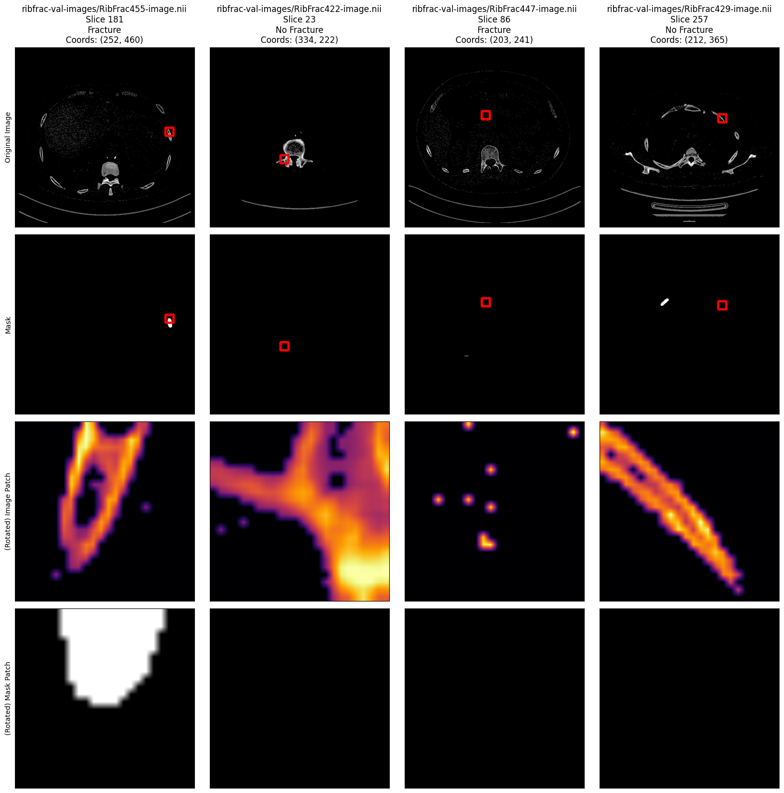

2.5D Patch extraction
Fracture slice
No-fracture slice
Extract all .nii files locally.
Build CSV listing all available slices.
At each epoch, Custom PyTorch Sampler selects equal number of fracture/no-fracture/tissue slices.
For every slice, randomly select bone coordinate and extract good patch.
Resize + random horizontal/vertical flip.
Fracture patch with context
Fracture mask
No-fracture patch with context
No-fracture mask

Slide 7
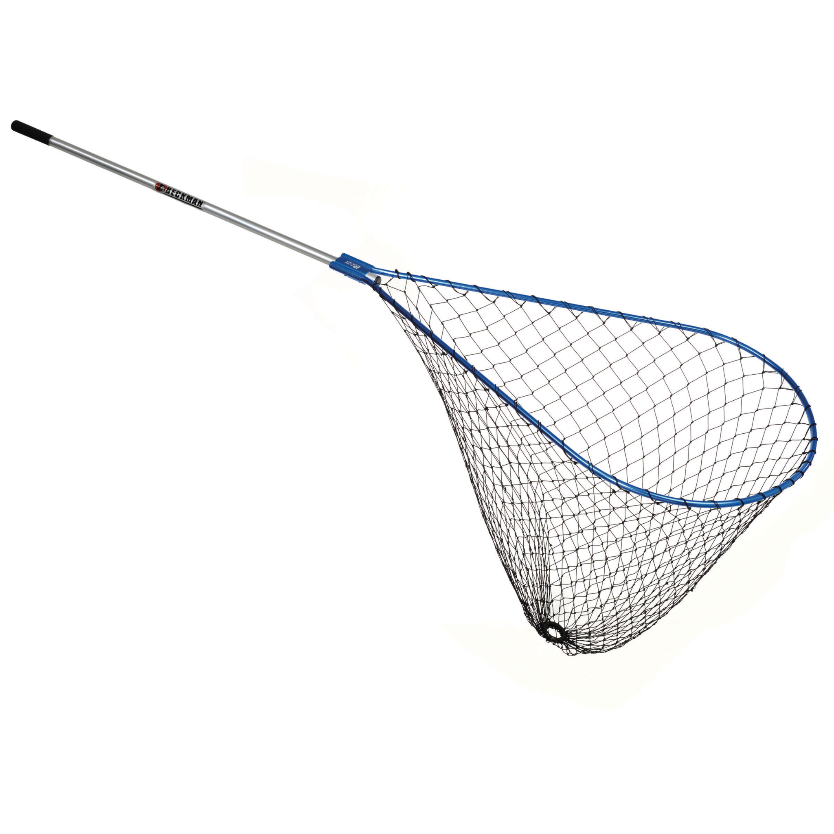

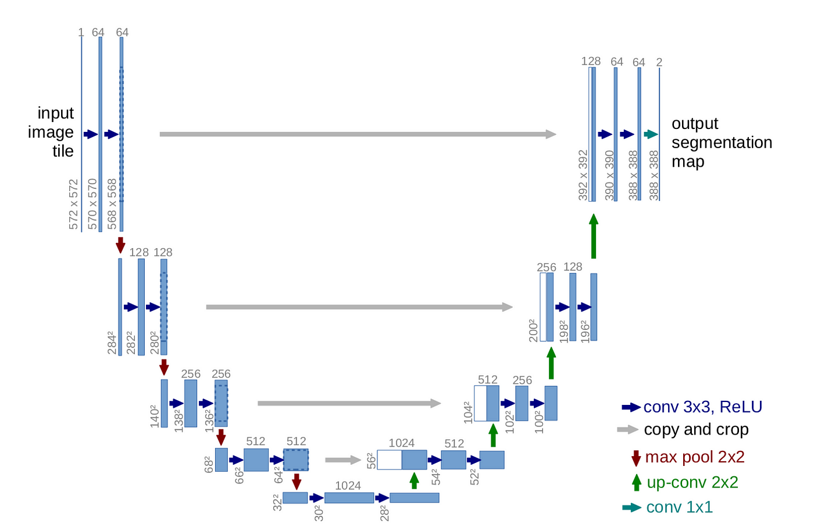
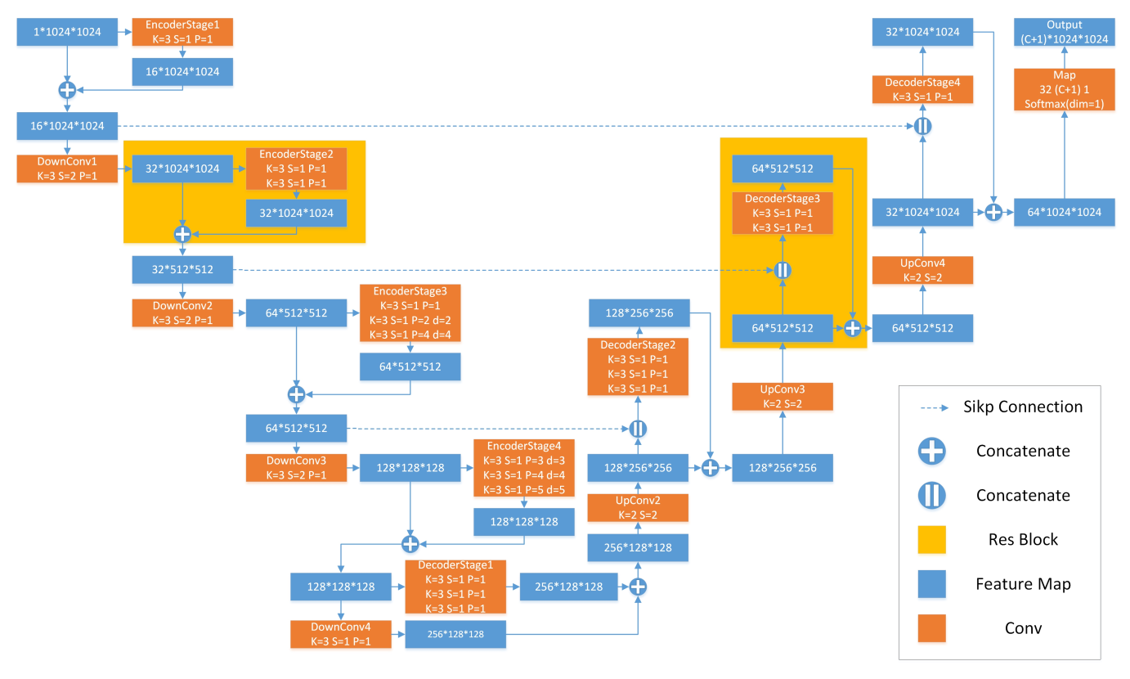
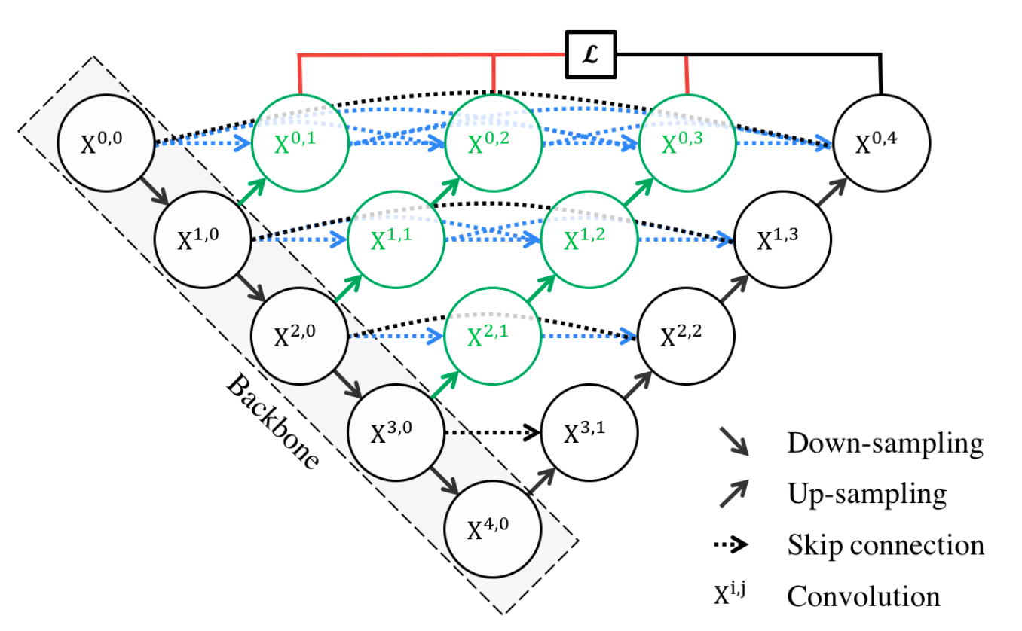
Baseline
Unet
2D-UNet
(Multi)ResUNet or UNet ++
ResUnet
Unet++
Notes:
The 2D-UNet architecture is a convolutional neural network framework commonly used in medical image segmentation tasks, designed to capture intricate spatial relationships by employing a U-shaped structure with encoding and decoding pathways, enabling precise pixel-level classification for segmenting structures or regions of interest within medical images.
The UNet++ architecture enhances the 2D-UNet by incorporating nested skip pathways, allowing for even more comprehensive feature extraction and refined segmentation performance in medical image analysis.
ChatGPT
The (multi)ResUNet builds upon the original UNet architecture by integrating residual connections, which enable the model to effectively capture both low-level and high-level features in medical images, enhancing segmentation accuracy and performance by mitigating vanishing gradient issues.
MultiResUNet builds upon the idea of ResUNet but extends it to operate at multiple resolution levels.
Both skip and residual connections enable gradients to flow better, but skip connections directly concatenate or merge features from different layers, while residual connections add the original input to the transformed output, aiding in better gradient propagation and network training.

Slide 8
Contribution
Unet ++ / (Multi)ResUnet
2.5D patches with context
Positional encoding
difference types of fracture happen in different places
relative x,y,z coordinates of the patch
Notes:
Unet ++ and (Multi)Resnet etc nog done for this challange but for example used for the tumor segmentation where the
2. Positional Enc
Dataset analytics:
mean size and location of fractures
Shape-Aware Rib Fracture Detection
Composite Attention
3. Ensemble model of 2.5D → find points to focus on and expand that particular point to a small 3d volume to look further.

Slide 9
Planning
Week 1-2:
Literature review
Training pipeline
Data visualization
Week 3-4:
Data analytics
Implement baseline
Week 4:
Preprocessing pipeline
Evaluation pipeline
Train 2D Unet baseline
Week 5:
Implement + train variations
Week 6: Analyses + report
Week 7: Presentation
Week 8: Exam

